Slide 1



Standards & Best Practices IRF Summit Conference, Stavanger, 4-5 October 2011
Jan de Jong, SODM
Steve Walker, UK HSE
Alf Reidar Johansen, OGP
Neil Reeve, ISO/TC67

Slide 2
Standards & Best Practices
Following Montara and Macondo:
Importance of comprehensive set of standards emphasised
Drive towards greater consistency of worldwide safe practice
IRF has a role
Key benefits of standards for IRF: Promote
Safety
Health
Protection of the environment
Must be joint effort of all stakeholders
See paper ”The involvement of IRF in setting standards and best practices” prepared for this conference.

Slide 3
Hierarchy of standards
National legislative regime
Laws
Regulations
Guidelines, Notices
Regulatory and enforcing authorities
Standard developing
organisations
International standards
Regional standards
National standards
e.g. ISO, IEC
e.g. CEN (Europe)
e.g. ANSI/API (US), DIN
(Germany) or NEN (NL)
Industry standards
Best or recommended practices
Guidelines
OGP, IADC, IMCA, API
Nogepa, OLF, UK oil & gas
Trade associations
Companies
Group specifications
Company specifications
(Project specifications)
Multinationals
Independents / business units
Manufacturers/ contractors

Slide 4
The bow-tie
Objective: reduce likelihood
(pro-active/preventative)
Objective: mitigate consequences
and re-instate (re-active)
Consequence
Threats
Barriers
Hazard
Recovery
Measures
Threats
Barriers
Top
Event
Threats
Barriers
Recovery
Measures
Threats
Barriers
???
???
Control (keep within control limits)
Prepare for emergencies
Global standards play role in
quality and effectiveness of
both prevention and mitigation barriers

Slide 5
Why should regulators be involved?
Because consensus standards can:
enhance technical integrity
be alternative to prescriptive legislation
reduce the need for regulatory document text
provide a “level playing field” between countries
enable cross border movement (especially mobile facilities)
make easier for regulator to amend guidance than amend supporting legislation.

Slide 6
OGP Reports
Value of standards (OGP Report 440)
Position paper on development & use of International Standards (381)
Regulators’ use of standards (426)
Global standards used locally worldwide (4210)
Deepwater wells (463)
OGP reports freely available at www.ogp.org.uk

Slide 7
Value of standards
Standards are the tools we use to organise our technical world
Quality improvement
Ensuring consistent and reliable engineering
Compatibility and efficiency (cost and time reduction)
Global trade (promotes trading, facilitates partnership and international operation)
Sharing and dissemination of the knowledge and experience
PS: References by seven global operating companies to more than 5.180 standards.

Slide 8
Position paper
Promote development and use of international standards
International standards should be used without modification
International standards should recognise regional variations
Avoid duplication of effort
Company specifications should be minimised
OGP encourages its members to be well represented on all critical standardisation work groups

Slide 9
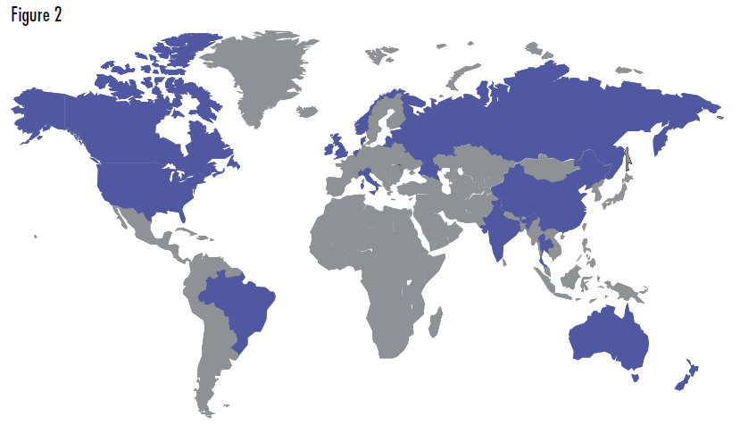
Regulators’ use of standards
Thirteen national regulators' examined with focus on the offshore petroleum industry.

Slide 10
Danish-Norwegian-UK references
DK+NO+UK reference 465 standard titles in total
Only 6 common (all) references

Slide 11
Conclusion on Regulators’ use of standards
Regulators make good use of standards!
Little harmonization by regulators in their use of standards.
Diversity of references provides additional work for global operators.
Majority of reference standards from US.
Duplication of standards.
References to international standards have increased compared to earlier analysis.

Slide 12
OGP GIRG Recommendations
Promote international standards
Robust standards and practices are critical to prevention of accidents
Enourage OGP members to meet or exceed and verify adherence to these standards.
Recognise existing standards as the baseline for industry improvement.
Promote use of industry good practices and standards as a basis for continuous industry improvement with additional GIRG recommendations.
Influence and renew ISO, API and other industry standards.
Harmonise international and national standards.
Support ISO/TC67 efforts following Montara & Macondo.
Encourage regulators to participate actively in international standards work and to make references to more globally relevant standards.

Slide 13
ISO/TC 67: Materials, equipment and offshore structures for petroleum, petrochemical and natural gas industries
Scope: Standardization of the materials, equipment and offshore structures used in the drilling, production, transport by pipelines and processing of liquid and gaseous hydrocarbons within the petroleum, petrochemical and natural gas industries.
Excluded: aspects of offshore structures subject to IMO requirements (ISO/TC 8).
www.iso.org

Slide 14
ISO/TC 67 Vision
Global Standards Used Locally Worldwide

Slide 15
Goals of ISO/TC 67
Prepare standards required by this industry
Prepare standards that are adopted worldwide by bodies such as ABNT (Brazil), API (USA), CEN (Europe), GOST R (Russian Federation), GSO (Gulf Region) and SAC (China)
Prepare standards that are recognized by regulators
Publish standards that enable companies to minimize their specifications
Deliver standards to the target dates on the agreed work programme

Slide 16












ISO/TC 67 Materials, equipment and offshore structures for petroleum, petrochemical and natural gas industries
WG 2 Conformity assessment
WG 7 Materials for use in H2S containing environments
SC 4
Drilling and production equipment
WG 5 Aluminium alloy pipe
Management Committee
WG 4 Reliability engineering & Technology
SC 2
Pipelines
WG 8 Materials, weldiing, NDO, etc.
WG 10 LNG equipment and facilities
SC 3
Drilling and workover fluids, and cement
WG 11 Coating & lining of structures and equipment
WG 12 CO2 aspects
SC 5
Casing, tubing and drillpipe
SC 6
Refinery equipment
SC 7
Offshore structures
SC 8
Arctic operations
ISO/TC 67 Organisation and secretariats (flags)
Re-established in 1989 with ANSI/API holding secretariat (till 2009)
Initial work program was based on approx 70 API standards
60 Member countries: 30 participating, 30 observing
Involves more than 3000 engineers around the globe
Last annual plenary meeting, Moscow, 14,15 September 2011
Next annual meeting, Rio de Janeiro, September 2012
MC meets three times per year, plus monthly telecons
Published standards: 151
Current work programme: > 95 standards (new + revisions)
Growth in LNG, CO2, arctic.

Slide 17
Membership continues to grow

Slide 18
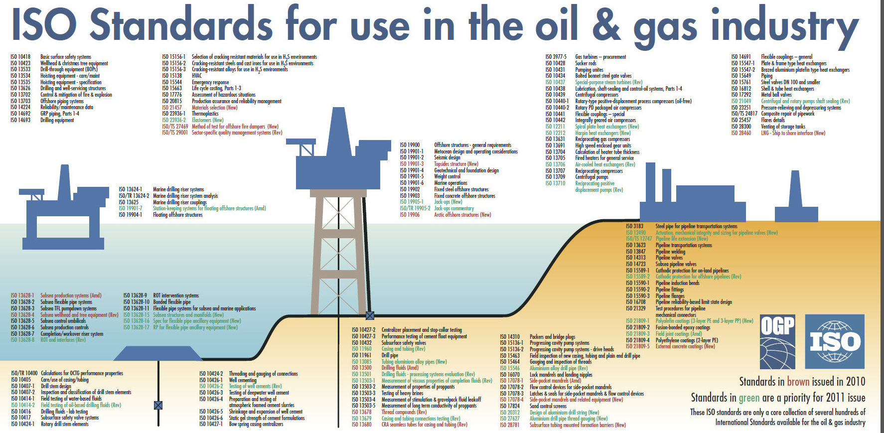
ISO/TC 67 has published 151 standards.
API has adopted 80 of these as joint API / ISO standards.
CEN has adopted 136 of these as joint European EN ISO standards.
Brazil (31), China (55), Gulf Region (78), Kazakhstan (89), Russia (30) etc. have also adopted (a number of) these as national standards. Recent and accelerating.
Companies use these as the basis for their company standards

Slide 19
Key principles
One country – one vote:
But almost all decisions, including document publication are based on consensus
Consensus:
Not unanimity, ..... but absence of sustained opposition to substantial issues by important stakeholder
Tripartite participation:
40% users (oil companies)
40% manufacturers/suppliers
20% academia, regulators, certification/classification bodies, trade unions etc.
Voluntary:
A standard does not in itself impose an obligation upon anyone to follow it
Such obligation may be imposed by legislation/regulation or contract
Verbal forms:
Shall indicates a requirement
Should indicates a recommendation
May indicates a permission
Can indicates a possibility
Regional annexes
Can meet the particular requirements of one region or country
Equipment versus process standards
Initial focus on equipment standards – now increasingly also standards for processes
Documented in ISO/IEC Directives (Parts 1 and 2)

Slide 20
Response to Macondo and Montara
ISO/TC 67 is reacting to the Macondo (US) and Montara (Australia) accidents:
Prepared action plan including immediate and longer term needs (ISO/TC67 document N 1119) – December 2010.
30 ISO standards (new and revisions) of which 10 are top priority
(Well integrity; Well control / equipment; Cementing; Development and implementation of HSE management systems; Competence of personnel
Working closely with all actors involved including API, IRF, CEN, NSOAF, OGP (standards committee and wells experts group), ….
The learnings from an accident in one country must be transferred globally.
International standards developed by ISO/TC 67 are one way of achieving this.
Stakeholders are requested to support and participate actively.
An action team is monitoring progress.

Slide 21
IRF participation
Regulator is key stakeholder
More participation from regulators welcome
Specifically:
Framing the portfolio of required documents
Ensuring document scopes are relevant
Debating detailed content on key issues

Slide 22
Concluding proposals (See details in paper)
Support the ISO (and IEC) standards system
Create a standing IRF “standards” sub-group
set clear priorities
monitor progress
engage with standards committees
influence standards management to meet IRF needs
Develop questionnaire for IRF members (standards usage)
Consider response to OGP Report “Regulators’ use of standards”; and consider making “list”
Distinguish roles on “Good practice” and “Best practice”

Slide 23
Thank you

Slide 24
Back-up

Slide 25

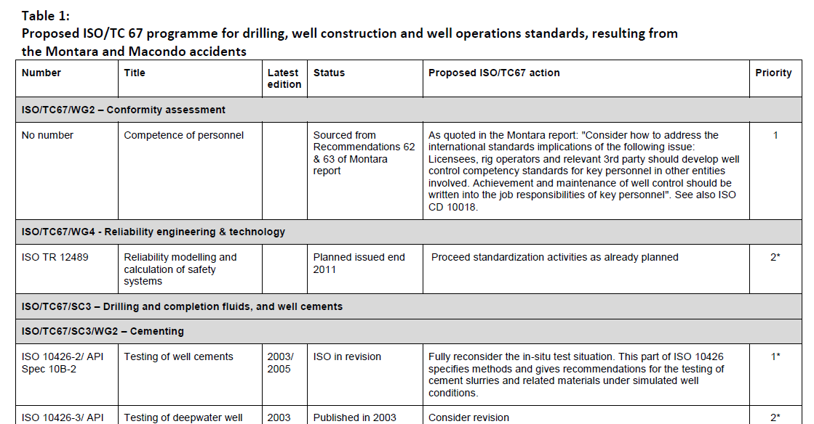
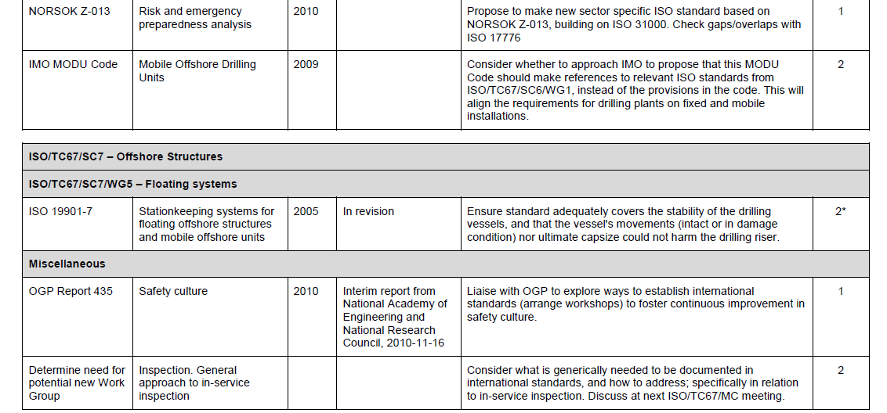
Doc TC67 – N 1119 – extracts
from the conclusion
To carry out the activities proposed in Table 1 will require considerable effort and resources …
Some of these activities can be seen as typical ongoing work of ISO/TC 67 …
…etc ...
Other proposed potential subjects are new…… these will require new resources from the interested stakeholder groups …
These stakeholder include: countries involved in the international oil industry; oil companies; equipment manufacturers; contractors; national regulators; certification bodies; professional and trade associations; standards organizations
Table 1 lists 30 items
ISO TC67 with OGP, API …

Slide 26
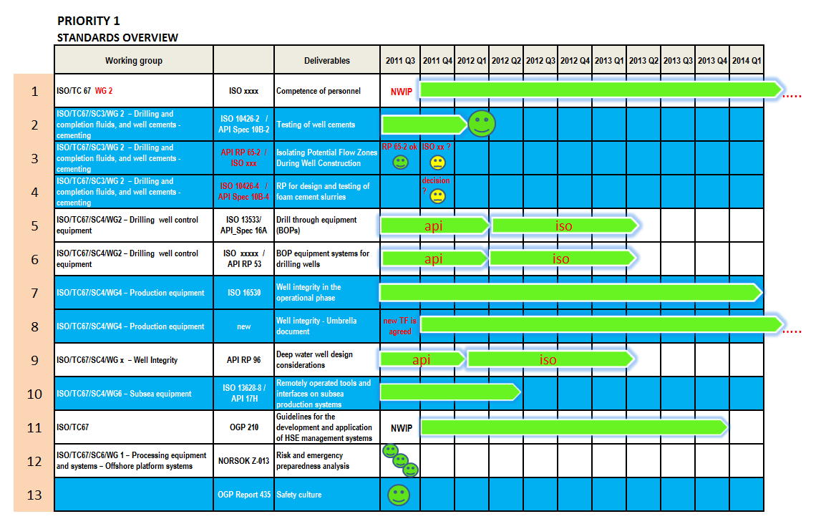
Timetable of priority 1 documents (today)

